Slide 1
Data Structures

Slide 2
What will you do in the following Scenario?
An emergency case arrives in a hospital
Essential system process asks for some resources during CPU Scheduling
Real life tasks which require some privileges compared to others

Slide 3
Priority Queue
Priority Queue is an extension of queue with following properties: Every item has a priority associated with it.
An element with high priority is dequeued before an element with low priority.
If two elements have the same priority, they are served according to their order in the queue.
Entry and exit are not purely of the FIFO kind

Slide 4
Types of Priority Queue
Min – Priority Queue
Max – Priority Queue
8 | 6 | 3 | 10 | 5 | 1 | 4
8 | 6 | 3 | 10 | 5 | 1 | 4
Smaller Number
Higher Priority
(e.g. Ranks)
Larger Number
Higher Priority
(e.g. Marks)

Slide 5
Priority Queue ADT
Abstract Data Type only states what operations are to be performed but doesn’t say how these operations will be carried out.
It does not specify how data will be organized in memory and what algorithms will be used to carry out the operations.
Priority Queue ADT:
removeHighestPriority()
getHighestPriority()
add(T element)
isEmpty()
size()

Slide 6
Implementation of Priority Queue
Using In-Built Class “PriorityQueue”
Using Arrays
Using Heaps

Slide 7
Using In-Built Class
Priority Queue ADT:
removeHighestPriority()
getHighestPriority()
add(T element)
isEmpty()
size()
PriorityQueue Class:
poll()
peek()
add(T element)
isEmpty()
size()

Slide 8
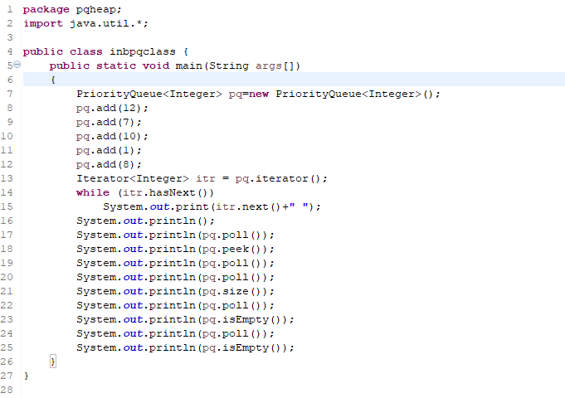
Using In-Built Class

Slide 9
Array Implementation
Two Scenarios:
Array Not Sorted
Array Sorted
8 | 6 | 3 | 10 | 5 | 1
1 | 3 | 5 | 6 | 8 | 10
Insertion – O(1)
Deletion – O(n)
Insertion – O(n)
Deletion – O(1)
e.g. Insert 9
e.g. Insert 9
8 | 6 | 3 | 10 | 5 | 1 | 9
1 | 3 | 5 | 6 | 8 | 9 | 10

Slide 10
Array Implementation
Array Sorted
1 | 3 | 5 | 6 | 8 | 10

Slide 11
Array Implementation
Array Sorted
1 | 3 | 5 | 6 | 8 | 10

Slide 12
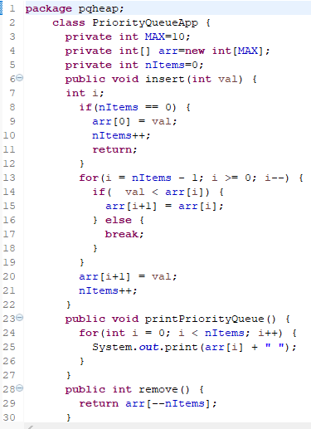
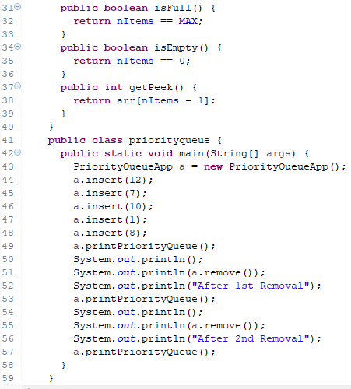
Array Implementation (Array Sorted)

Slide 13

Array Implementation (Array Not Sorted)

Slide 14
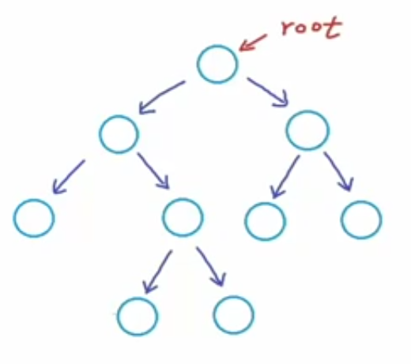
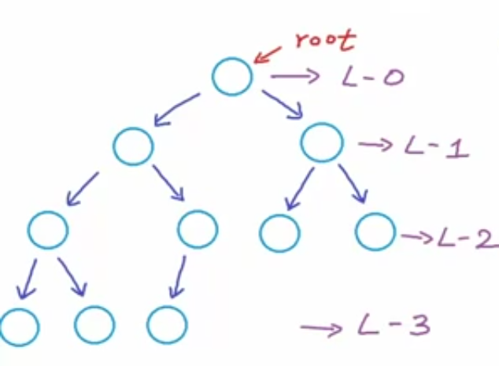
Visiting again - Complete Binary Tree
Complete Binary Tree: All levels, possibly except the last are completely filled and all nodes are as left as possible.
Proper Binary Tree: Each node can have either 2 or no children.

Slide 15
Observation - In Complete Binary Trees

Slide 16
Heaps
A Heap is a special Tree-based data structure in which the tree is a complete binary tree. Generally, Heaps can be of two types:
Max-Heap: In a Max-Heap the key present at the root node must be greatest among the keys present at all of it’s children(descendants). The same property must be recursively true for all sub-trees in that Binary Tree.
Min-Heap: In a Min-Heap the key present at the root node must be minimum among the keys present at all of it’s children(descendants). The same property must be recursively true for all sub-trees in that Binary Tree.

Slide 17
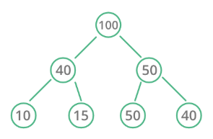
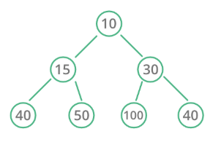
Types of Heaps
Max Heap
Min Heap

Slide 18
Insertion in Heaps
Given a Binary Heap and a new element to be added to this Heap. The task is to insert the new element to the Heap maintaining the properties of Heap.
Process of Insertion:
Insert the new element at the end of the Heap.
This newly inserted element may distort the properties of Heap for its parents. So, in order to keep the properties of Heap, heapify this newly inserted element following a bottom-up approach.

Slide 19
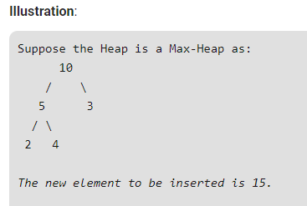
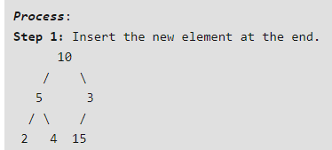
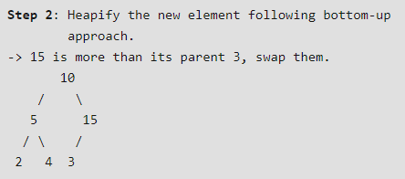
Insertion in Heaps

Slide 20
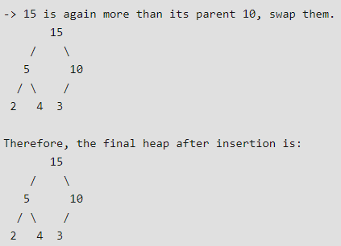
Insertion in Heaps

Slide 21
Insertion in Heaps

Slide 22
Deletion in Heaps
Since deleting an element at any intermediary position in the heap can be costly, so we can simply replace the element to be deleted by the last element and delete the last element of the Heap.
Replace the root or element to be deleted by the last element.
Delete the last element from the Heap.
Since, the last element is now placed at the position of the root node. So, it may not follow the heap property. Therefore, heapify the last node placed at the position of root.

Slide 23
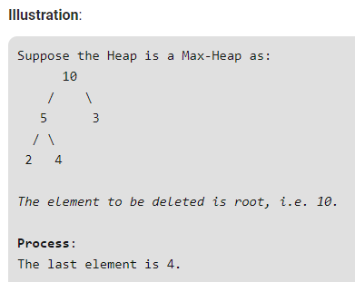
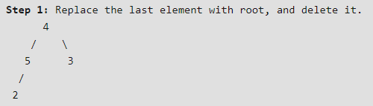
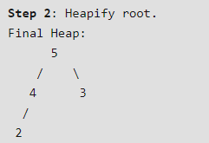
Deletion in Heaps

Slide 24
Deletion in Heaps

Slide 25
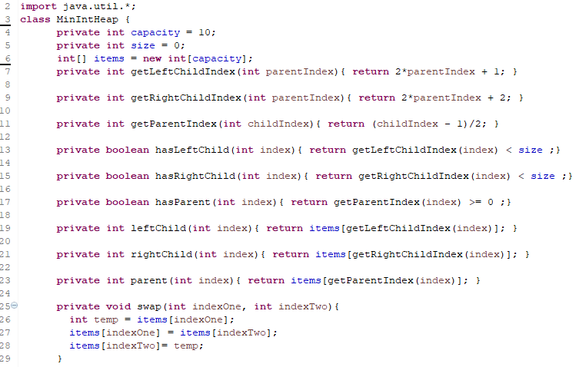
Array Implementation

Slide 26
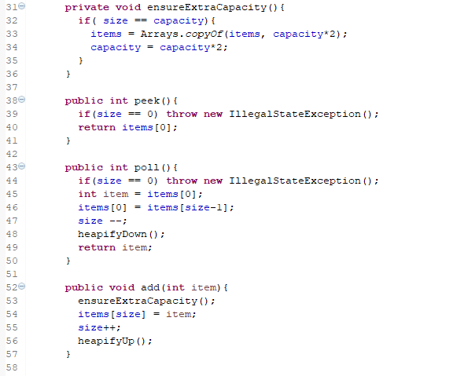
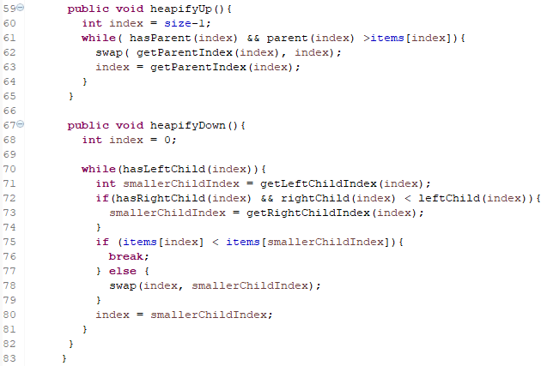
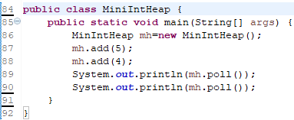
Array Implementation

Slide 27
THANK YOU

